Slide 1



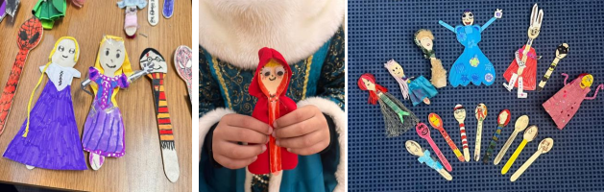



Week beginning 24.2.25
We are excited to be to celebrate World Book Day across the week beginning Monday 3rd to Friday 7th March! Our World Book Day will take place on Friday 7th March and it will follow the theme of ‘Read Your Way’. We would like to invite children to come to school in what they like to read in. This could be dressing up as a character, wearing pyjamas or simply something comfortable. As part of our celebrations, a Bookworms Book Fair will also take place throughout the previous week (from 24th– 28th February) with all books on sale for only £2.50. This will take place in the small hall library as well as online. We will also be taking part in lots of activities to share and celebrate our love of reading. These will include sharing stories, taking part in online author events, spending time on the library in the small hall and considering how they see themselves as a reader. Reading Forum have also launched a competition as part of World Book Day. Children are invited to turn a wooden spoon into something amazing!
No Vaping/Smoking on site
Please remember there is no vaping or smoking allowed on our School site.
Spring Term
24 February - 4 April 6 weeks
Summer Term
22 April - 23 May 4 weeks 3 days
2 June - 29 July 8 weeks 2 day
Don’t Forget to check out our Facebook page to see what other things have been happening in school:
https://www.facebook.com/SuttonRoadPrimaryandNursery

Slide 2


Attendance
Our
Our school attendance target is 97%
Last week our attendance stood at 94.93%
As a THANK YOU to all our families who ensure their child attends school regularly.
At the end of each term, we will enter the name of every child who achieves attendance of 97% or above into a draw and the winning family will win a £20 Just Eat Voucher!
We acknowledge that attendance is a family effort, and we wanted to reward a lucky family with a voucher that all could enjoy!
The next draw will take place on Friday 4th April 2025 for the Spring term. Watch this space for details. Good Luck!”
Diary Dates
Week beginning 18th November – is our Parents Evening week – letter and booking have been sent
Monday 24th February – School starts
Thursday 27th February 2025 – Year 4 and 5 Football Completion
Week beginning 3rd March - Parents evenings– see ParentMail for booking appointments
Wednesday 5th March – Y6 B Team Football Fixture
Friday 7th March 2025 – World Book Day
W/c 10th March – Dogs Trust in school (assembly and workshop)
Tuesday 11th March – Year 2 Partake theatre
Contact us…
Staff are available to talk to briefly, before or after school (but please remember they may need to arrange an alternative time if you need a longer chat).
Or contact the school office on office@suttonroad.org
u

